Slide 1
PowerShell From The Trenches - Workflows ...Of Course Yes!
Fast track hands on Powershell Worflows
Jorge Besada, DBA, Carnival Cruise Line

Slide 2


Slide 3
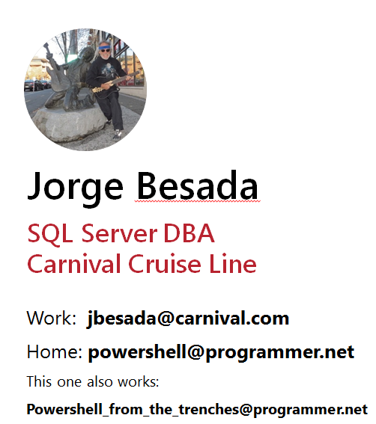
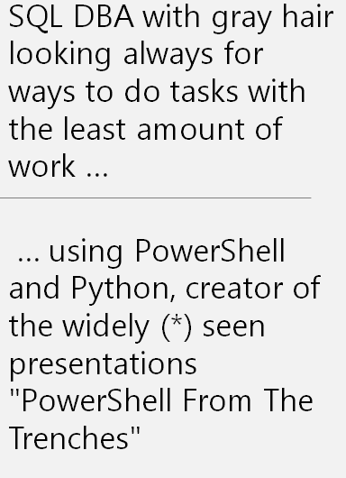

Slide 4
This is the plan
1) WorkFlow – what are they? – the book definition
2) The Hello World workflow program
3) A sample program using jobs
4) A sample program using workflows
5) Jobs program – the workflow version
Goodie

Slide 5
WorkFlow – what is it – book definition
Windows PowerShell workflows are designed for scenarios
where these attributes are required:
* Long-running activities.
* Repeatable activities.
* Frequently executed activities.
* Running activities in parallel across one or more machines.
* Interruptible activities that can be stopped and re-started, which includes surviving a reboot of the system against which the workflow is executing.

Slide 6
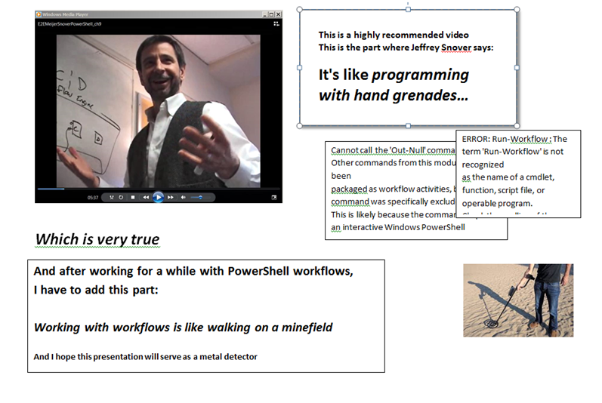

Slide 7
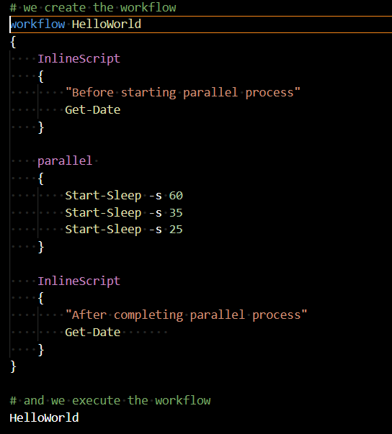
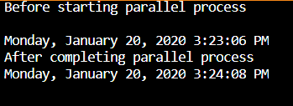
Sample workflow , my HelloWorld version
Take home lessons:
Yes, workflows work as expected:
The total time is the longest of the three “programs”
You define a workflow like a function, and call it
The InlineScripts are your friend

Slide 8
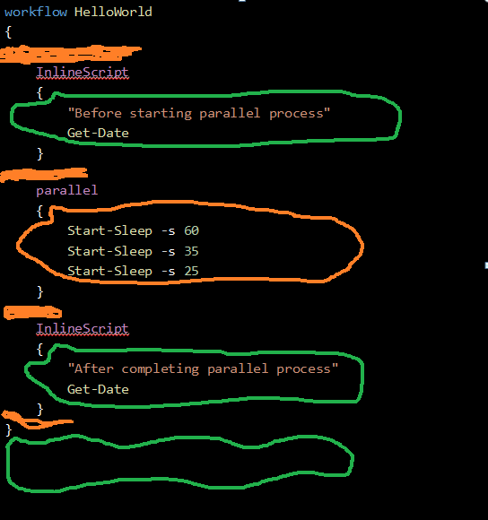
First Things First - Scope and Visibility Green – powershell business as usual area Orange: workflow rules apply
workflow HelloWorld
{
InlineScript
{
"Before starting parallel process"
Get-Date
}
parallel
{
Start-Sleep -s 60
Start-Sleep -s 35
Start-Sleep -s 25
}
InlineScript
{
"After completing parallel process"
Get-Date
}
}

Slide 9
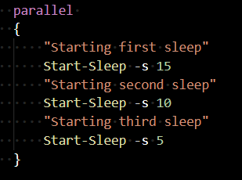


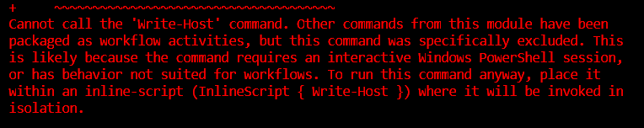

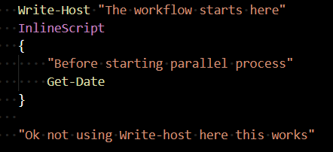
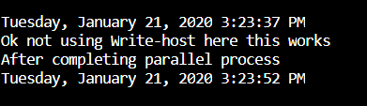
Get used to weird things
This is nice
This is naughty
So these are the suggestions:
In case of errors: use InlineScript when possible
In case of doubt: use InlineScript
When inside Workflow: the error messages are quite detailed ☺, learn from them

Slide 10
Good to know you can return stuff from the InlineScript
Good to know
you can pass stuff to the InlineScript
FROM THE BOOK
InlineScript Variables
By default, the variables that are defined in a workflow aren't visible to the commands in the InlineScript script block. To make workflow variables visible to the InlineScript, use the $Using scope modifier. The $Using scope modifier is required only once for each variable in the InlineScript.
Returning variables in InlineScript
InlineScript commands can change the value of the variable that was imported from workflow scope, but the changes aren't visible in workflow scope. To make them visible, return the changed value to the workflow scope

Slide 11
InlineScript : pass and receive values
workflow HelloWorld
{
"This will used as parameter in below inlinescript"
$p1 = "a|b|c|d|e"
$p1
# This DOES NOT WORK - InlineScript is not a Script Block:
# InlineScript ($p1) orInlineScript { param ($p1) ... }
"--------------------------------------------------------"
InlineScript #Showing use of a parameter (AKA external value)
{
# DON'T DO THIS (in case you did not read above note): param($using:p1)
"received a parameter"
$using:p1
"doing something to it"
$r1 = ($using:p1).Split('|')
$r1
}
"--------------------------------------------------------"
$retval = InlineScript #Showing how to return something from the inlinescript
{
$s1 = "some internal value generated within"
return $s1
}
" A return value:"
$retval
"--------------------------------------------------------"
$retval2 = InlineScript #Combining both: use parameter, return value
{
"received a parameter"
$using:p1
"doing something to it"
$r1 = ($using:p1).Split('|')
return $r1
}
"Return value:"
$retval2
InlineScript
{
"After completing parallel process"
Get-Date
}
}
HelloWorld # and we execute the workflow
Notes:
We can pass values to InlineScripts, just remember the $using

Slide 12
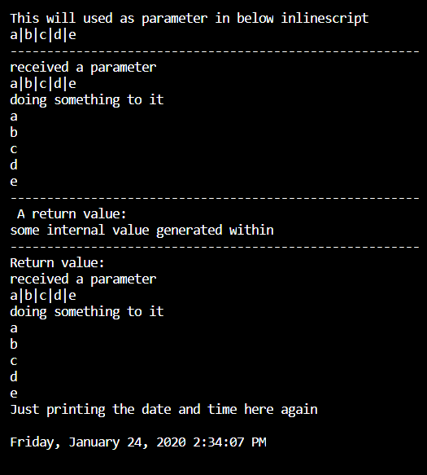
And here we see the output
Notes:
Ok now we just need to add a little thing before we continue

Slide 13
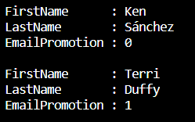
Functions in powershell work fine …
# Script_Blocks_are_a_good_thing_A.ps1
# using a function
function Invoke-Sqlcmd3_db ($ServerInstance,$Query, $Database)
# Based on Chad Millers Invoke-Sqlcmd3
{
$QueryTimeout=600
$conn=new-object System.Data.SqlClient.SQLConnection
$constring = "Server=" + $ServerInstance + ";Trusted_Connection=True;database=" + $Database
$conn.ConnectionString=$constring
$conn.Open()
if($conn)
{
$cmd=new-object System.Data.SqlClient.SqlCommand($Query,$conn)
$cmd.CommandTimeout=$QueryTimeout
$ds=New-Object System.Data.DataSet
$ds
$da=New-Object System.Data.SqlClient.SqlDataAdapter($cmd)
[void]$da.fill($ds)
$conn.Close()
$ds.Tables[0]
}
}
#Sample use:
$server = "WORKSTATION\Sqlexpress"
$database = "AdventureWorks2017"
$query = 'select top 5 [FirstName],[LastName],[EmailPromotion] from Person.Person'
$r = Invoke-Sqlcmd3_db $server $query $database
$r
Notes:
Yes they work fine but get in the habit of using script blocks for everything for workflows

Slide 14
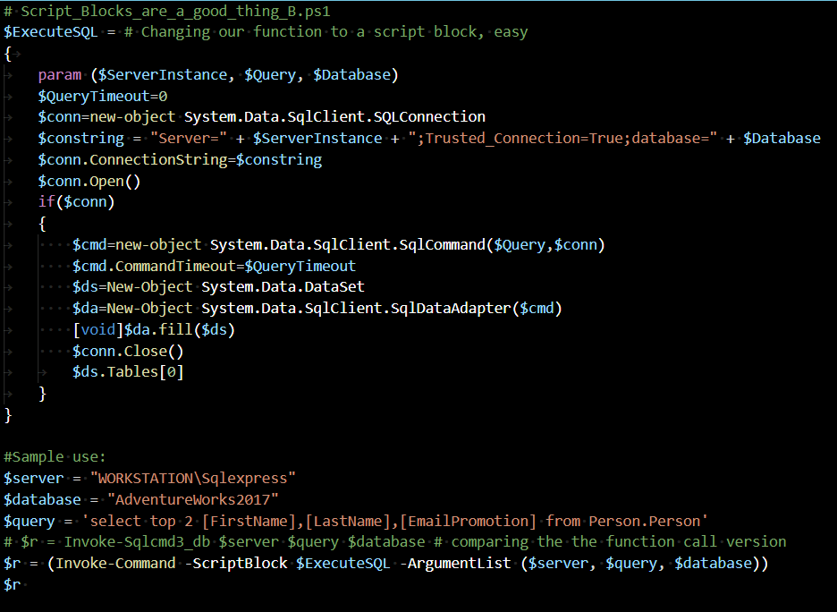
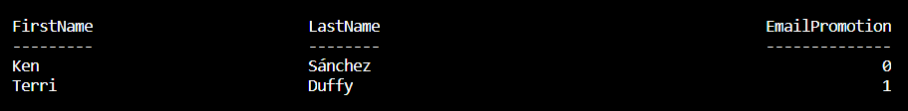
Script Blocks are better friends in workflows
Notes:
Good practice for the workflower: use script blocks and save yourself aggravations

Slide 15
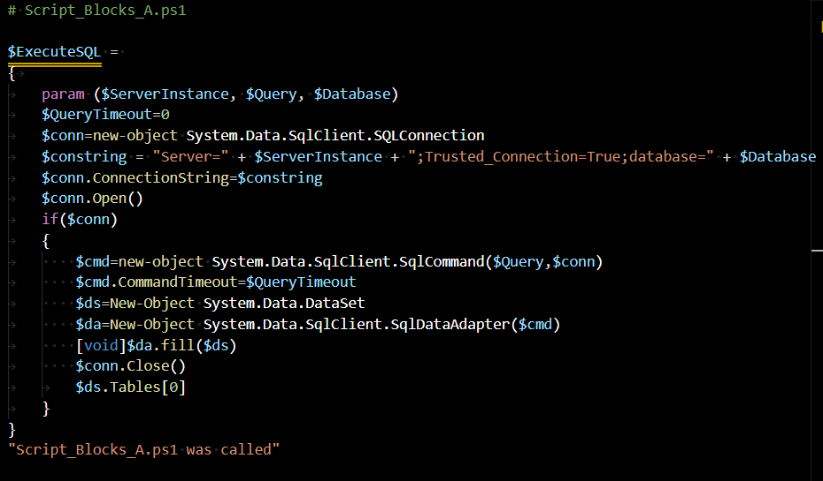
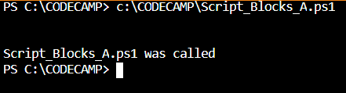
Notes on scope and organizing the code
Notes:
Sample module containing a single script block

Slide 16
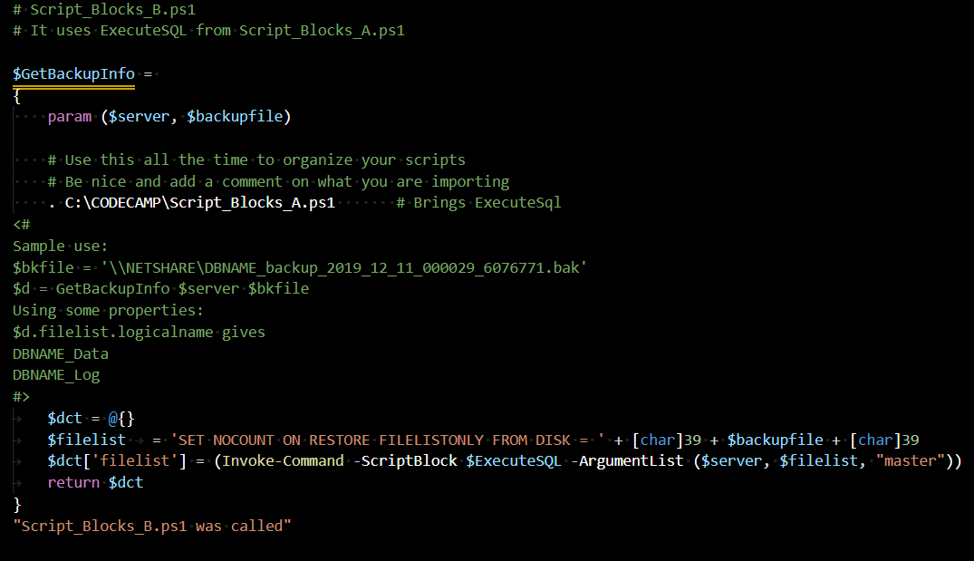
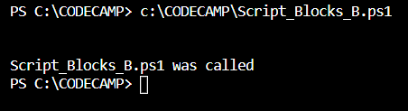
We can import code using the dot and the file name
Nothing is being done yet.

Slide 17
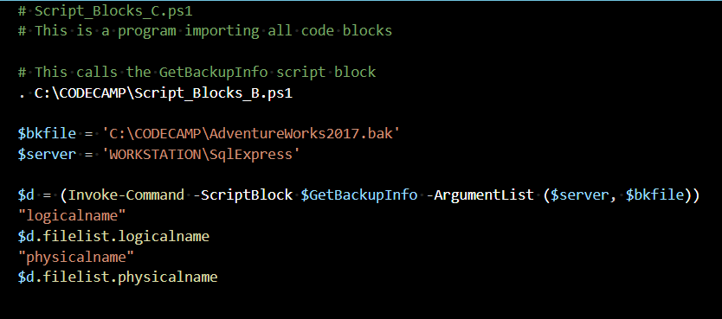
Showing calls for the script blocks from a main program
Script_Blocks_B.ps1 was called
logicalname
AdventureWorks2008R2_Data
AdventureWorks2008R2_Log
physicalname
C:\CODECAMP\AdventureWorks2017.mdf
C:\CODECAMP\AdventureWorks2017_log.LDF
PS C:\CODECAMPMP>

Slide 18
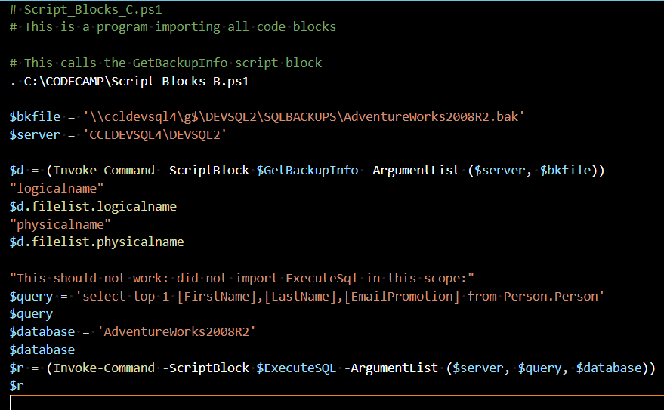
Checking the import process and the usual suspects
Notes:
Note to selves: this does not happen running the code in the Visual Studio Code editor, it caches the ExecuteSQL code and the code does not err. ALWAYS TEST USING a cmd window and batch file and powershell script, don’t be lazy

Slide 19
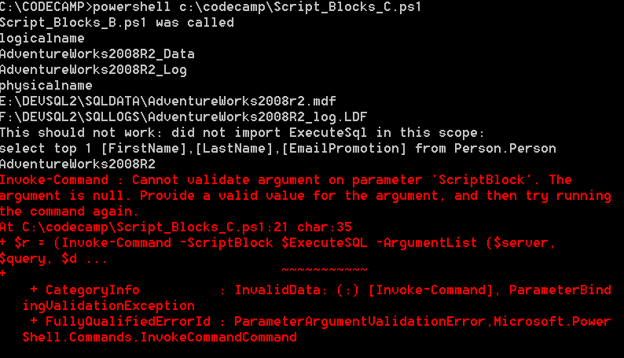
What happens if you do not import and you do a real test Create a cmd file to call your powershell script Run it from a cmd window
Notes:
Doing the test the right way

